Slide 1
Computer Vision…
Presented by: Muthumariappan G
Class: III-DCE
Date: 21-07-2025

Slide 2
Introduction
🧠 What is Computer Vision?
A field of AI that enables machines to interpret and understand visual data.
🎯 Why is it Important?
Powers facial recognition, self-driving cars, medical imaging, etc.

Slide 3
How Does Computer Vision Work?
1. 📸 Image Acquisition :
Capture image or video using camera.
2. 🧹 Preprocessing :
Resize, grayscale, remove noise.
3. 🔍 Feature Extraction
Detect edges, corners, patterns.
4. 🧠 Interpretation
Use ML or DL models to understand image.

Slide 4
🔍 Feature Extraction
Edges – Boundaries between objects
Corners – Points where edges meet
Shapes – Circles, lines, etc.
Patterns – Textures and repeated structures
Deep learning models learn features automatically

Slide 5
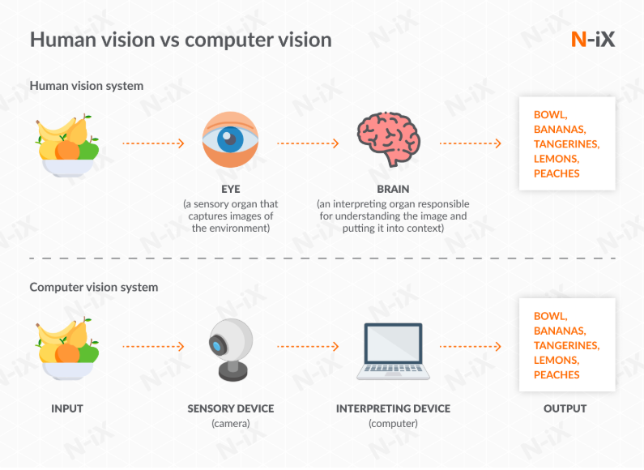
Computer Vision Work….
Reference: https://www.n-ix.com/computer-vision/

Slide 6
Applications of Computer Vision
Facial Recognition
Self-driving Cars
Medical Imaging
Industrial Automation
Augmented Reality
Object Detection & Tracking

Slide 7
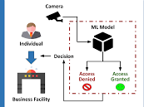
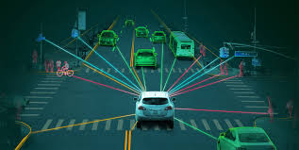
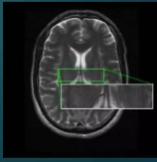
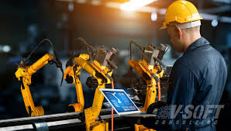
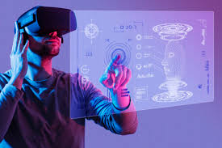
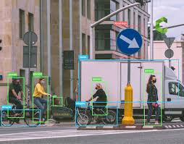
Facial Recognition
Self-driving Cars
Medical Imaging
Augmented Reality
Industrial Automation
Object Detection & Tracking

Slide 8
✅ Computer Vision Benefits
High Accuracy – Detects objects precisely
Automation – Reduces human effort
Faster Processing – Quicker than manual analysis
Cost-Effective – Saves time and money
Real-Time Usage – Used in many live applications
Improves Medical Diagnosis – Better disease detection

Slide 9
Challenges of Computer Vision
Requires Large Datasets
Computationally Intensive
Can Fail in Poor Lighting or Angle
Privacy and Ethical Concerns
Expensive to Implement at Scale

Slide 10
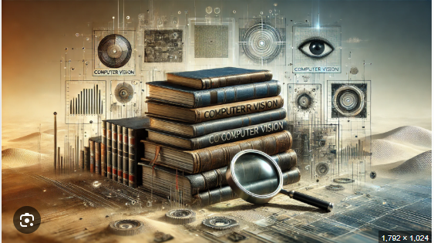
History of Computer Vision
1960s: Began as a part of AI research.
1970s–80s: Focus on basic image processing.
2000s: Machine learning introduced.
2010s: Deep learning revolutionized CV with CNNs.
Reference : https://genovasoft.com/fr/the-history-of-computer-vision/ & https://chatgpt.com/

Slide 11
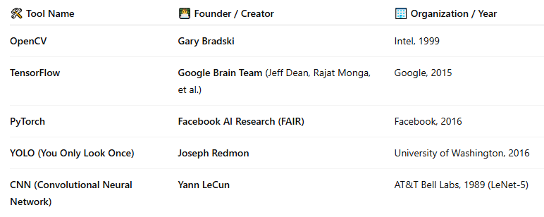




Tools and Technologies in CV
OpenCV – Open-source CV library
TensorFlow / PyTorch – Deep learning frameworks
YOLO – Real-time object detection model
CNN – Convolutional Neural Networks
Reference: https://chatgpt.com/

Slide 12
Conclusion & Summary
Computer Vision is transforming the way machines see and think.
Used in healthcare, transport, industry, and security.
Deep learning has greatly improved CV accuracy.
The future of vision-based AI looks bright.

Slide 13
🙏 Thanks for your attention!
Any Questions?

